Slide 1
Boolean Retrieval Term Vocabulary and Posting Lists Web Search Basics
Presented By:
Aakash Pradeep Kulkarni
Chirag Jain
Ishan Gote
Kavya Potluri
Nikhil Jadhav
Pranay Prafulkumar Jain
Sai Ruthvik Reddy Goranti
Samruddhi Godbole
Urma Haldar

Slide 2
Information Retrieval
The effectiveness of an IR system (i.e., the quality of its search results) is determined by two key statistics about the system’s returned results for a query:
Precision: What fraction of the returned results are relevant to the information need?
Recall: What fraction of the relevant documents in the collection were returned by the system?
To get perfect recall: just retrieve everything
To get good precision: retrieve only the most relevant

Slide 3
Boolean Retrieval Model
Answers any query that is a boolean expression (AND OR NOT Joins)
Views each document as a set of terms
Precise output; Document matches condition or not
Example: Which plays of Shakespeare contain the words Brutus and Caesar, but not Calpurnia?
Example: Email Search: Results that you get will not be ranked by relevance, but in a chronological manner (most recent first)
Example: Westlaw (commercial); Boolean Search and ranked retrieval both offered Document ranking only wrt chronological order Expert queries are carefully defined and incrementally developed Largest commercial legal search service – 500K subscribers

Slide 4
Question
By which two statistics do we determine the effectiveness of an IR system?

Slide 5
Information Retrieval Problem : Example
Information Retrieval is finding materials(documents) of an unstructured nature(text) that satisfies an information need from within large collections(in computers).
The simplest form of retrieving a document is through linear scanning: grepping. But it is not an effective solution. Why?
1. Slow for large amount of data.
2. Grep is line-oriented , IR is document- oriented
3. Need more flexible matching operations.
To avoid linear scan, documents should be indexed in advance.
Inverted Matrix: A Dictionary of terms. Each term is a list of documents it occurs in.

Slide 6
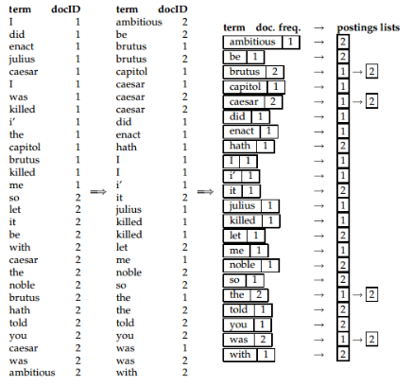
Building an inverted index
Doc 1: I did enact Julius Caesar: I was killed i’ the Capitol; Brutus killed me.
Doc 2: So let it be with Caesar. The noble Brutus hath told you Caesar was ambitious.
1. Collect the documents to be indexed
2. Tokenize the text, turning each document into a list of tokens
3.Do linguistic preprocessing, producing a list of normalized tokens (indexing terms)
4.Index the documents that each term occurs in by creating an inverted index consisting of a dictionary and postings.

Slide 7
Processing Boolean Queries
Boolean queries are queries that use AND, OR and NOT.
Primary commercial retrieval tool for 3 decades.
Precise and you will get the results you want.
Example:
Query - Brutus and Caesar and not Calpurnia:
Take the vectors for Brutus, Caesar, and Calpurnia
Complement the vector of Calpurnia
Do a (bitwise) and on the three vectors 110100 and 110111 and 101111 = 100100

Slide 8
Question
Which 3 operators are used in Boolean queries?

Slide 9
Term vocabulary and posting lists
Document delineation and character sequence decoding
Obtaining the character sequence in a document.
Digital documents are bytes in a file.
Convert byte sequence into linear sequence.
For simplicity we assume that our documents are list of characters.
Whole idea is that text is a linear sequence of characters.

Slide 10
Choosing a document unit
Its important to determine what document unit for indexing is.
For example, in an email folder, we may consider it as one document or individual email message.
For long documents, we have to take care of indexing granularity.
For example, its bad idea to index entire book as one document.
Search for ‘Chinese toys’ will refer the pages where China is on first page and toys on last page.
Hence, document will be subdivided and individual chapter or pages will be considered as a document.
Smaller documents means matches will be relevant.
But if units get too small, the terms are distributed over large number of documents.
Clearly its a precision/recall trade off.

Slide 11
Question
What are character encoding techniques other than ASCII?

Slide 12

Determining the Vocabulary of Terms
Given a character sequence and a defined document unit, tokenization is the task of chopping it up into pieces, called tokens
Token normalization is the process of canonicalizing tokens so that matches occur despite superficial differences in the character sequences of the tokens

Slide 13
StopWords, Stemming And Lemmatization
Some extremely common words which would appear to be of little value in helping select documents matching a user need are excluded from the vocabulary entirely. These words are called stop words.
The goal of both stemming and lemmatization is to reduce inflectional forms and sometimes derivationally related forms of a word to a common base form.

Slide 14
Question
Who developed the Google Page Rank Algorithm?

Slide 15
Faster postings list intersection via skip pointers
Why Skip pointers are needed ?
IF the sizes of our two posting lists are x and y, the intersection takes x+y operations. Skip pointers allow us to potentially complete the intersection in less than x+y operations.
What are Skip Pointers ?
Skip pointers are effectively shortcuts that allow us to avoid processing parts of the postings list that will not figure in the search results.

Slide 16
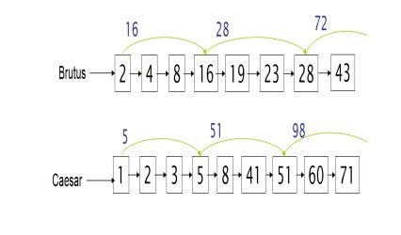
Faster postings list intersection via skip pointers
The presence of skip pointers only helps for AND queries, not for OR queries

Slide 17
Where do we place skips?
More skips means shorter skip spans, and that we are more likely to skip ,lots of comparisons to skip pointers, and lots of space storing skip pointers.
Fewer skips means few pointer comparisons, long skip spans ,fewer opportunities to skip
A simple heuristic for placing skips is that for a postings list of length P, use √ P evenly-spaced skip pointers.
Building effective skip pointers is easy if an index is relatively static
Disadvantage : It is harder if a postings list keeps changing because of updates. A malicious deletion strategy can render skip lists ineffective.

Slide 18
Question
What are the Pros of using the skip pointers?

Slide 19
Phrase Queries
Many names we search online are Phrases. As many as 10% of web queries are phrase queries, and many more are implicit phrase queries.
Most recent search engines support a double quotes to support Phrase Queries.
When we want to search query Stanford University by considering it as a single phrase. I went to University at Stanford is not a match.
BIWORD INDEXES
One approach to handling phrases is to consider every pair of consecutive terms in a document as a phrase. For example, the text”A B C” would generate the biword: “AB” and “BC”. When we have longer queries then we get more biword which were treated as vocabulary term.
Issues of Biword Indexes:
False Positives
Index blow up due to bigger dictionary

Slide 20
Handling Phrase Queries
Positional Posting
Since the Biword indexes is still not a standard solution. Positional Postings put each distinct term into posting list then record their frequency and the position in the document. For example we have “A B” and then we are going to seek the position of A, and then going to find the term B which has 1 position higher than A. Thus we can find “A B”.
For example: “to be”
To: { 2:1, 17; 4:8, 16, 22, 30;….
Be: { 3:1, 5; 4:17, 19, 23;…………….
Positional index can handle phrase queries and proximity queries.
But the positional index size gets much larger.
Combinational Schemes:
The strategies of biword indexes and positional indexes can be fruitfully combined.
If users commonly query on particular phrases, such as Michael Jackson, it is quite inefficient to keep merging positional postings lists.
A combination strategy uses a phrase index, or just a bi-word index, for certain queries and uses a positional index for other phrase queries

Slide 21
Question
What are the issues of Biword indexes?

Slide 22

Web Graph
The Web Graph describes the directed links between pages of the World Wide Web. A directed edge connects page X to page Y if there exists a hyperlink on page X, referring to page Y. Where X and Y are two vertices of giant Web Graph.
Two nodes of the web graph joined by a link
This anchor text is generally encapsulated in the href attribute of the <a> (for anchor) tag that encodes the hyperlink in the HTML code of page A, and is referred to as anchor text
The web graph can be constructed by crawling the web. The in-links or out-links of web pages formulates the web-graph
Two families of models have been introduced. The first family contains models whose aim is to explain the power law for degree distribution, while the second one is more based on structural properties of the Web graph
Page Rank is procedure of calculating rank of web-page by solely deriving ranking by link structure of Web Graph.
The Web Graph can be used for detecting web pages of similar topics, through graph-theoretical properties only, like co-citation

Slide 23
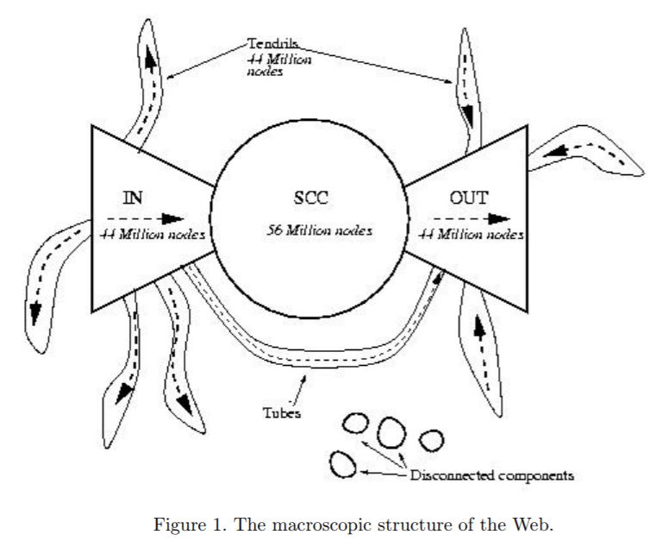
Building an inverted index
The shape of web is of Bowtie. The three major categories of web pages are IN, OUT and SCC.
A web surfer can pass from any page in IN to any page in SCC
Likewise, a surfer can pass from page in SCC to any page in OUT
Finally, the surfer can surf from any page in SCC to any other page in SCC.
However, it is not possible to pass from a page in SCC to any page in IN, or from a page in OUT to a page in SCC.
in several studies IN and OUT are roughly equal in size, whereas SCC is somewhat larger; most web pages fall into one of these three sets.
The remaining pages form into tubes that are small sets of pages outside SCC that lead directly from IN to OUT, and tendrils that either lead nowhere from IN, or from nowhere to OUT

Slide 24
Question
What are three major categories of web page?

Slide 25
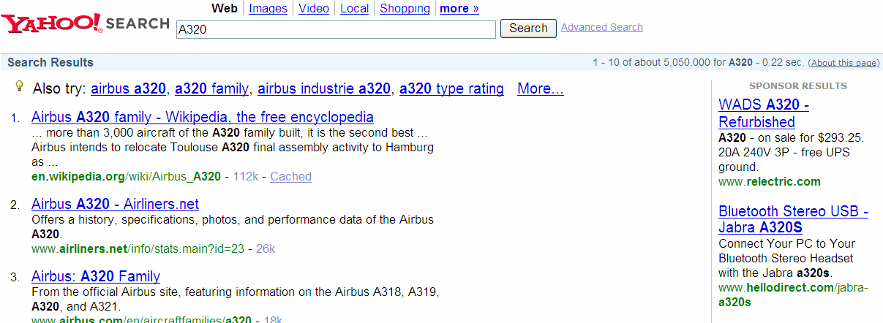
Advertising as the economic model
Early in the history of the Web, companies used graphical banner advertisements on web pages at popular websites. The primary purpose of these Advertisements was branding.
Typically advertisements are priced as CPM (Cost per mil) or CPC (Cost Per Click) model.
GoTo was a pioneer in this direction, for every query q GoTo would accept bids from the company and return web pages ordered based on highest bid first.
Current search engine follow a combination of “Pure” search engines and “Sponsored” Search engines.
They provide pure search results algorithmic search as the primary response to a user’s search, together with sponsored search results displayed separately and distinctively to the right of the algorithmic results.
(Search advertising triggered by query keywords. Here the query A320 returns algorithmic search results about Airbus aircraft, together with advertisements for various non-aircraft goods numbered A320, that advertisers seek to market to those querying on this query. The lack of advertisements for the aircraft reflects the fact that few marketers attempt to sell A320 aircraft on the web.)

Slide 26
The search user experience
It is crucial to understand who uses web search. Web search users tend to not know or not care about the underlying heterogeneity of the web content. They do not essentially no the syntax of query language or how to phrase a query.
More user traffic a web search engine can attract, the more revenue it stands to earn from sponsored search.
Google identified 2 principles :
A focus on relevance, specifically precision rather than recall in the first few results.
[Saves user time in locating information they seek]
A user experience that is lightweight, meaning that both the search query page and the search results page are uncluttered and almost entirely textual, with very few graphical elements.
[Provide user experience that is extremely responsive and fast]
Three broad categories into which common web search queries can be grouped:
Informational : seek general info on broad topic, returns multiple web pages. [e.g. “Cloud computing”]
Navigational : seek website or home page of single entity, [e.g. Lufthansa airlines]
Transactional : seek list of services that provide interface for various transactions e.g. purchase a product
Categorizing query based on a type can be challenging. But, it is important in governing algorithm search results and deciding suitability of the query for sponsored search results.

Slide 27
Question
Identify the Web search query category: [Informational /Navigational / Transactional]
(1) “Facebook” , “YouTube”
(2) “Purchase Samsung Galaxy S3”

Slide 28
Index Size and Estimation
One of the determining factors of the quality of Web search engines is the size of their index.
Given two search engines, what are the relative sizes of their indexes?
A search engine can return a page that has not been fully or even partially indexed.
Search engines organize indexes in various tiers and partitions, not all pages indexed are examined on every search.
Rude estimation under an (unrealistic) assumption: there is a finite size for the web from which each search engine chooses an independent, uniform subset to index.
Using this assumption we can use classical estimation technique known as capture-recapture method.

Slide 29
Near-Duplicates and Shingling
The Web contains multiple copies of the same content. By some estimates, as many as 40% of the pages on the Web are duplicates of other pages.
Search engines try to avoid indexing multiple copies of the same content, to keep down storage and processing overheads.
We can remove duplicates by using Shingling technique.
WHAT IS SHINGLING?
In natural language processing a w-shingling is a set of unique shingles (therefore n-grams) each of which is composed of contiguous subsequences of tokens within a document, which can then be used to ascertain the similarity between documents.
The symbol w denotes the quantity of tokens in each shingle selected, or solved for.
As an example, consider the following text: a rose is a rose is a rose.

Slide 30
Questions
By estimate what percentage of pages on web are duplicate?

Slide 31
Questions?

Slide 32
Thank You

